Slide 1
Many Paths to Reform
New Perspectives on the Progressive Era

Slide 2
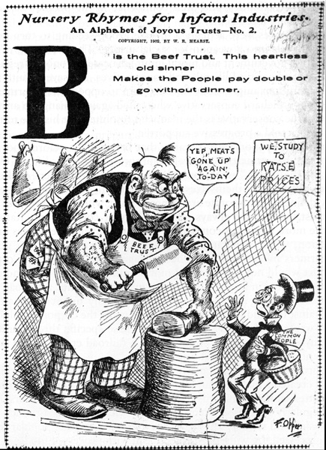
“B is the Beef Trust” Anti-Trust Cartoon, c. 1902

Slide 3
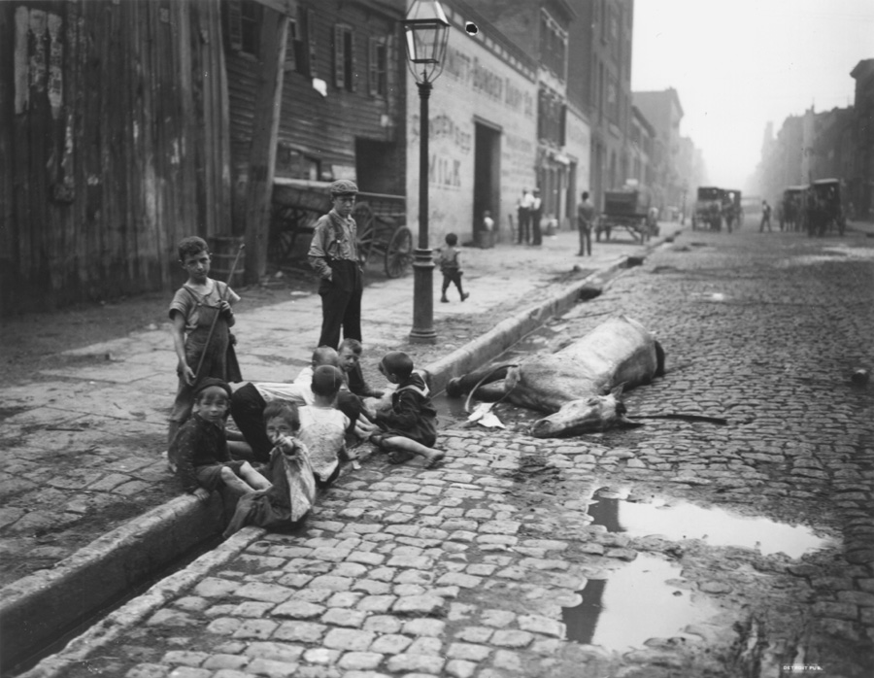
Street Scene of Children Playing Near a Dead Horse, c. 1900

Slide 4
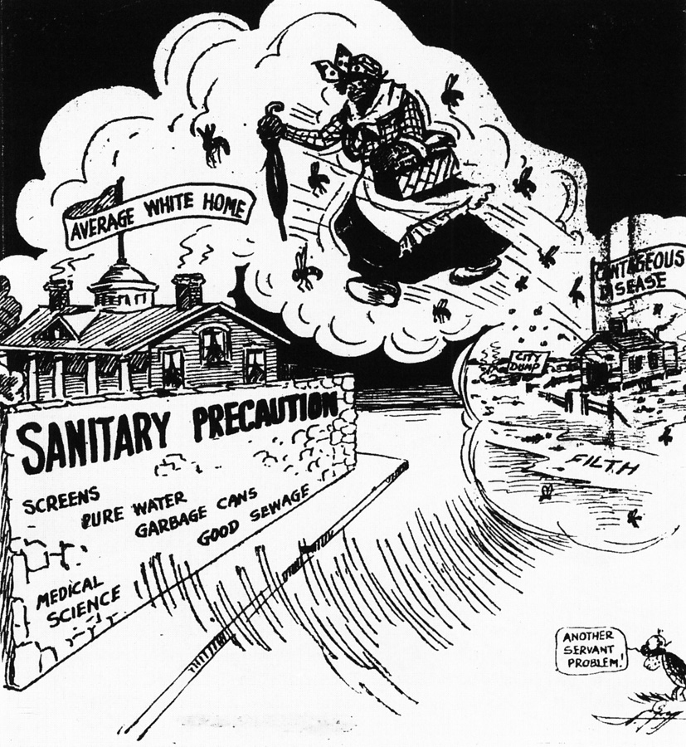
Cartoon from The Atlanta Constitution, c. 1914

Slide 5
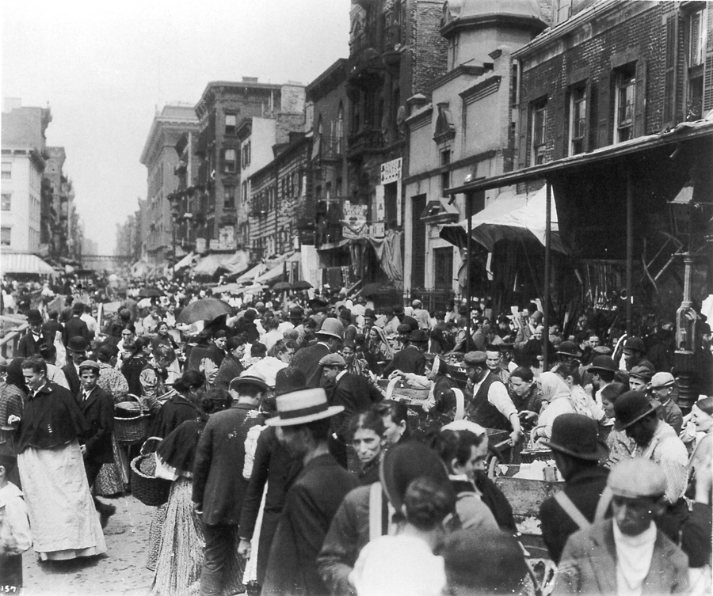
Lower East Side Crowd Photo, c. 1898

Slide 6
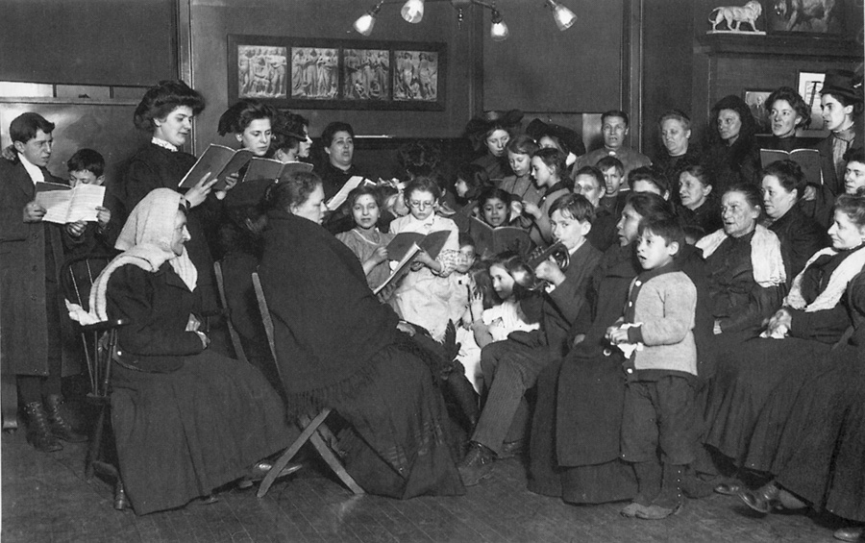
Lewis Hine, “The singing class at Hull House, Chicago, 1910”

Slide 7
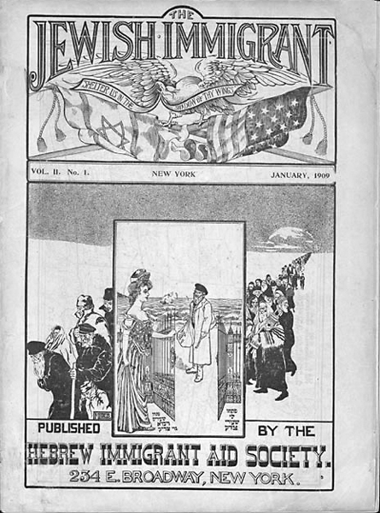
Cover of the the Hebrew Immigrant Aid Society magazine,
The Jewish Immigrant, c. 1909

Slide 8
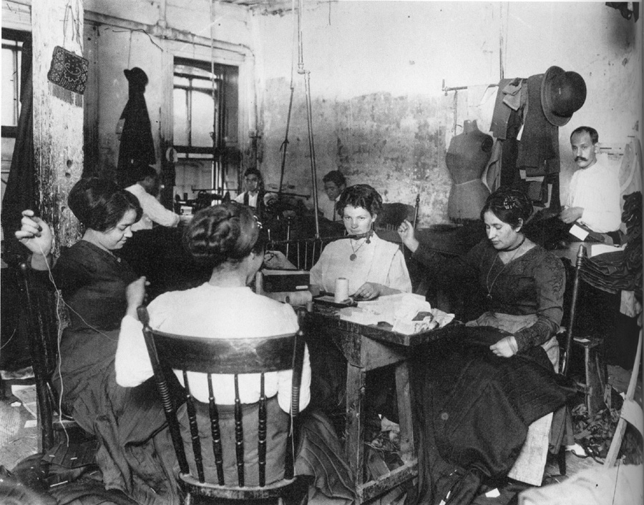
Female Garment Workers in Tenement Sweatshop
New York City, c. 1900

Slide 9
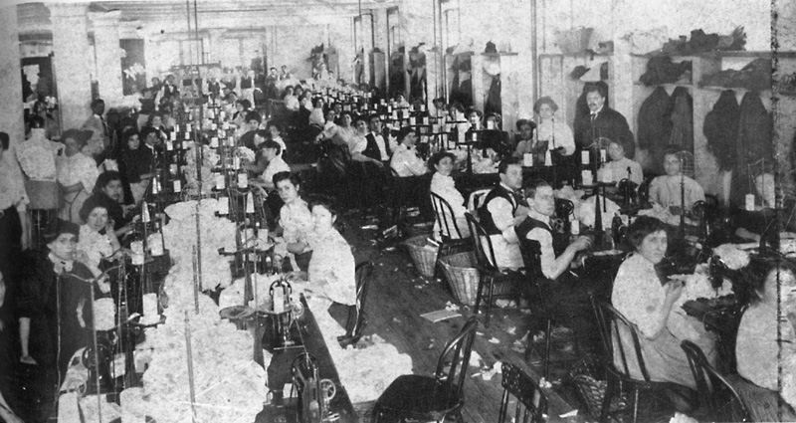
Garment Workers in Industrial Sweatshop, c. 1909

Slide 10
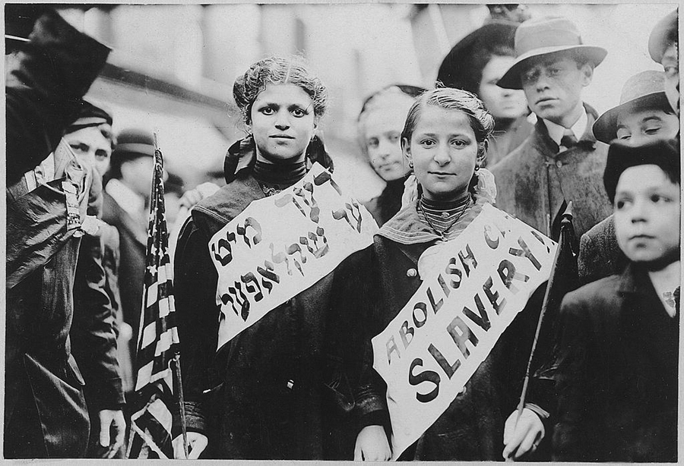
“Abolish Child Slavery!” Parade Against Child Labor, May 1, 1909

Slide 11
Legal Ages of Consent in Selected States, 1885 and 1920
State | 1885 | 1920
Alabama | 10 | 16*
California | 10 | 18
Delaware | 7 | 16*
District of Columbia | 12 | 16
Florida | 10 | 18*
Georgia | 10 | 14*
Kentucky | 12 | 16*
Louisiana | 12 | 18*
Maryland | 10 | 16
Massachusetts | 10 | 16
Mississippi | 10 | 18*
New York | 10 | 18
North Carolina | 10 | 16*
South Carolina | 10 | 16*
Tennessee | 10 | 18*
Virginia | 12 | 16
West Virginia | 12 | 16
*The law in these states made sexual intercourse with underage females a criminal offense under a statute that typically referred to “carnal knowledge of female child”; the rape statute was a separate law.
Information for table from Mary E. Odem, Delinquent Daughters: Protecting and Policing Adolescent Female Sexuality in the United States, 1885-1920 (1995), pp. 14-15.

Slide 12
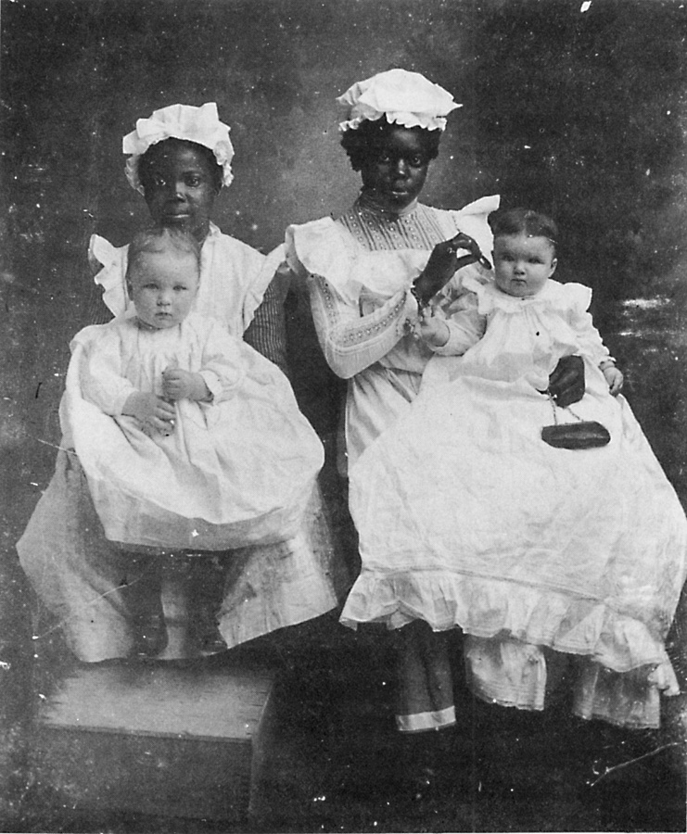
Child Nurses from Macon, Georgia, c. 1903

Slide 13
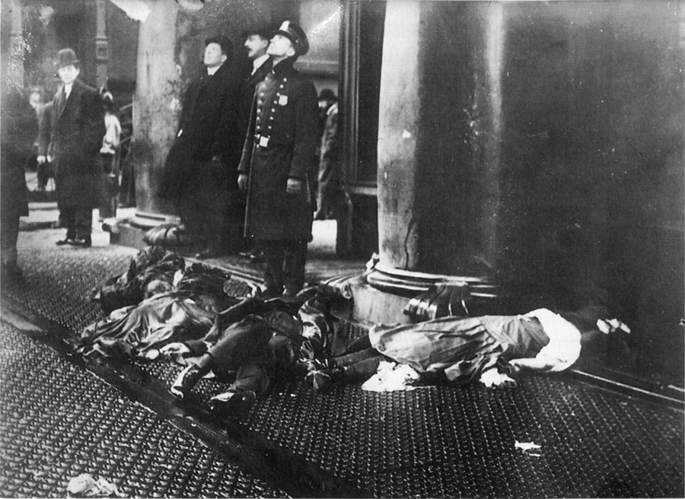
Bodies on Sidewalk, Triangle Shirtwaist Factory Fire, March 25, 1911

Slide 14
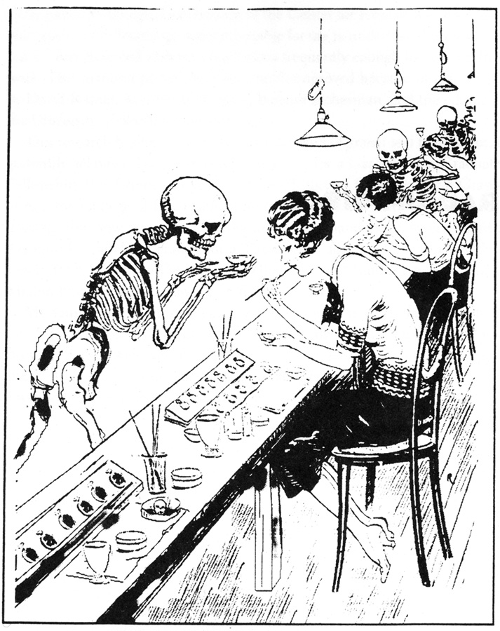
Cartoon on Workplace Poisoning from American Weekly, February 28, 1926

